Slide 1
Sealion
Teoh Teik Toe
ITOM/NBS
ttteoh@ntu.edu.sg
97905202

Slide 2
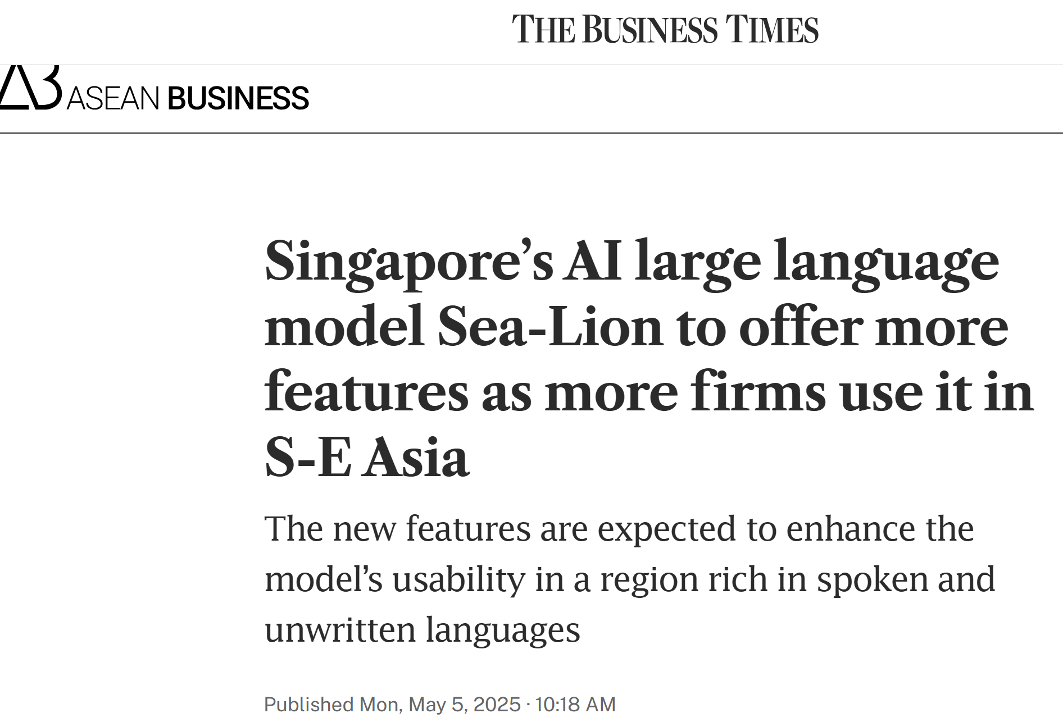
https://www.businesstimes.com.sg/international/asean/singapores-ai-large-language-model-sea-lion-offer-more-features-more-firms-use-it-s-e-asia

Slide 3
Recording: https://1drv.ms/v/c/f2f2b67b8c6b3629/ER_SkvUuJZ9EvyLfN66Ms_wBqafL7gtC3lU7PNdp6_5C_Q?e=u9Eu1H https://sea-lion.ai/ https://huggingface.co/aisingapore/Llama-SEA-LION-v3.5-8B-R https://github.com/aisingapore/sealion https://t.me/sealion_ai_bot

Slide 4
import transformers
import torch
model_id = "aisingapore/Llama-SEA-LION-v3.5-8B-R"
pipeline = transformers.pipeline(
"text-generation",
model=model_id,
model_kwargs={"torch_dtype": torch.bfloat16},
device_map="auto",
)
messages = [
{"role": "user", "content": "describe singapore"},
]
outputs = pipeline(
messages,
max_new_tokens=256,
)
print(outputs[0]["generated_text"][-1])
CHANGE TO GPU
print(outputs[0]["generated_text"][-1]["content"])

Slide 5
telegram

